Slide 1

The Care Act in Reading

Slide 2
Why do we need the Care Act?
Things have changed and moved on………
Ready to meet growing demand
Based on strengths of individuals and communities
Legal framework is out of date
National Assistance Act 1948: established the welfare state
Prevention rather than reaction
1948
2014…
Builds and formalises good practice
Clear and consistent care for people and their carers
It works best when we work in partnership with people, their carers and our colleagues
Notes:
Things have changed in a positive way….. People are living longer, expectations are growing, practice has evolved – current system not fit for purpose
Legal framework is based on legislation of the National Assistance Act where institutional care was considered best. PRESS
Its out of date - built over 60 years with around 30 acts piece by piece with no consolidation so its complex. Disempowering and inconsistent. PRESS
ASC practice has evolved based on learning gained from people using service. Focus has shifted to embrace what is important to the person, their carers. Learned from the power of direct payments. The Act seeks to embed these in the system. PRESS
So here we are with a system that has evolved but based on outdated legislation that needs to be fit for purpose: PRESS each one

Slide 3

What does the Care Act do 2015-2016?
It focusses care and support around the person, their needs and outcomes – rather than based on disability, setting or types of service
It simplifies and clarifies the law making it easier to navigate so people who need care, carers and those who manage and work in the system can understand
It provides for a new capped costs system for funding care and support
safeguarding
well-being
control
prevention
Notes:
Two year ambitious programme set nationally to address the issues I have mentioned: PRESS x 2
Focusses on the person and builds services around them PRESS
It clarifies the law PRESS
It seeks to address the issues of a sustainable system with a focus on funding social care to make it affordable and fair

Slide 4
What will people say?
“I am supported to maintain my independence for as long as possible”
“I understand how care and support works, and what my entitlements and responsibilities are”
“Care and support are responsive to my needs”
“I am happy with the quality of my care and support”
“I know that the person giving me care and support will treat me with dignity and respect”
“I am in control of my care and support”
“ My carer is recognised and supported “
Notes:
“I am supported to maintain my independence for as long as possible”
Prevention in the widest sense of services available and information and advise on maintaining your own wellbeing/ Integration and co-operation with partners
“I understand how care and support works, and what my entitlements and responsibilities are”
Information and advice – whole system, what it looks like, where to go, whats on offer – comprehensive/Assessment for all levels of need and eligibility/Applies if you move areas/Financial information and advice – social care/wider financial and legal implications
“Care and support is responsive to my needs”
Support planning/Transition
“I am happy with the quality of my care and support”
Quality & market/care market failure
“I know that the person giving me care and support will treat me with dignity and respect”
Workforce development/Safeguarding
“I am in control of my care and support”
Personalised care and support/Integration
“My carers is recognised and supported”
Carer assessment and support plan and inclusive to the process, whole family approach
Some of these will be mentioned as the day goes on

Slide 5
Whole System Implications/Risks
Biggest change to Social Care services in 60 years
Wide scale programme over 2 years:
  Resources
  Increased demand
  Increased costs
  Up skilling workforce
Tension between prevention & reducing budgets
Provider markets
Opportunities

Slide 6




The Care Act in Reading…
Information, advice & advocacy and prevention
OUTCOME: Enabling people to stay well and live as independently as
possible with access to timely information and proactive support
2. Assessment, eligibility & care planning
OUTCOME: Assessing and supporting people to plan their care in a
proportionate way based on a national eligibility framework
3. Carers
OUTCOME: Ensuring Carers are on an equal footing to those they care for
In terms of entitlement and are supported to continue in their caring role whilst maintaining their wellbeing
4. Quality & diversity of services
OUTCOME: Enabling people to access a market place providing choice and quality and supporting an honest and collaborative partnership with our providers
Notes:
Duty to prevent, duty to provide I&A (channels, trigger points). New duties for independent advocacy and independent financial advice. Reading Services Guide
New national eligibility, right to assessments & support planning. Focus on wellbeing, prevention. Introduction of self-assessments as default, with support for those that need it.
Carers assessment and right to support planning (vs. DP). Whole family approach – young carers
Market shaping – MPS, quality, engaging with providers about gaps (conferences)

Slide 7
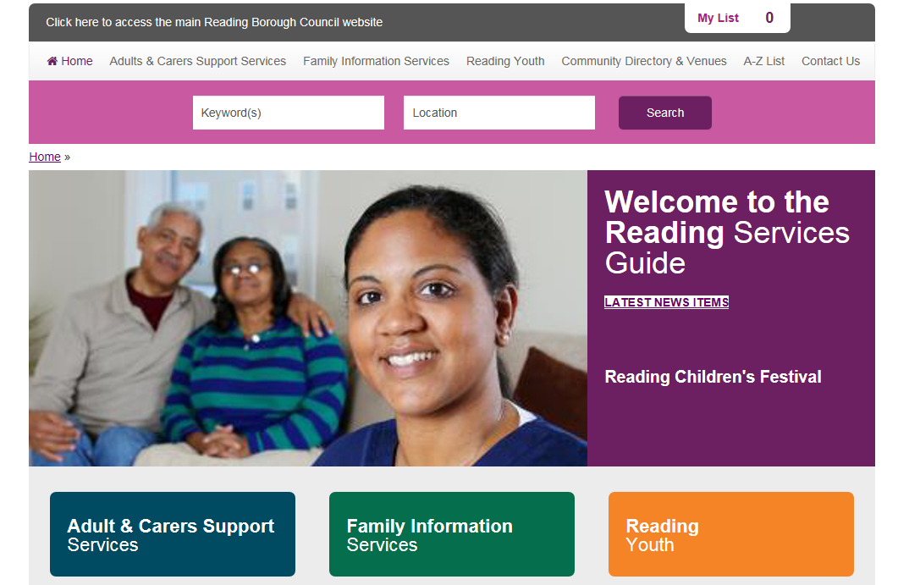

Slide 8



The Care Act in Reading…
5. Care market failure
OUTCOME: Having a sound understanding of the care market will ensure
people have access to appropriate care and support
6. Funding reform
OUTCOME: People will understand their responsibilities for funding their
own care based on a fair and equitable system and will have access to
sound information and advice
7: Safeguarding
OUTCOME: People will be safeguarded against harm, abuse or neglect as
far as possible through a multiagency approach ensuring it is ‘everyones business’
Notes:
5. Provider closure protocol
6. New Charging Framework (local discretion about this – preventative and carers services free of charge). Deferred Payment changes. 2016 changes
7. Statutory responsibilities for partners to share information, SABoard,

Slide 9
What does this mean for the people of Reading?
You may need care and support if you have a condition such as dementia, or other problems that affect your quality of life or ability to carry out daily activities.
If you have care and support needs, we can provide the following for you & your carer…
an assessment of the care and support you need, a plan detailing what services are right for you and whether you are eligible for state support
info & advice on the services available to help you stay well
reablement, rehab & other preventative services
advice on local services and how much they cost
You will still be responsible for some care-related expenses…
Every year we will review your care needs and your financial situation. From April 2016 we will keep a record of how much eligible care you have needed in total.
You pay what you can afford towards the cost of your care, you can defer the payment of residential care fees so that you don’t have to sell your home in your lifetime to pay for care.
We can help you with costs you can’t afford if you have less than £23k of wealth. From April 2016 if you receiving residential care the amount may change.
If you are in residential care, you will pay towards your living expenses, just like you would if you were living in your own home. This is expected to be around £12k a year in 2016.
You are responsible for the cost of any additional services that you choose to have beyond what the local authority would provide, such as having a second bedroom in a care home, or help with lower level care needs.
Care costs after April 2016 are capped at £72k if you are aged over 65, which is the limit on what you will have to spend on eligible care over your lifetime.
Once you have reached the cap your local authority will pay the reasonable costs to meet your eligible care needs for the rest of your life. If you receive financial support then you could spend less than this amount.
Notes:
What will it look like?

Slide 10
The Care Act in Reading
Consultation ran November 2014 – February 2015
New approaches signed off by councillors in March 2015:
  Charging Framework
  Prevention Framework, Adult Social Care Information & Advice Plan
  Market Position Statement

Slide 11
Summary for Providers – Opportunities 2015
Services focussed on prevention including information & advice
Provision of Independent advocacy
Provision of independent financial information and advice
Support for people to complete self assessments

Slide 12
Changes from April 2016
Introduction of the CARE CAP
Introduction of CARE ACCOUNTS
New CAPITAL LIMITS (extended means test)
Duty to arrange Care Home accommodation for self-funders where requested (along with a new power to charge administration costs of arranging care for self-funders)

Slide 13
From April 2016
Care Cap
A limit on the amount paid towards social care costs in a lifetime
Applies to eligible care costs only
Individuals in care home accommodation continue to pay an amount for general living expenses (set by DH, or a financially-assessed lower amount)
Notes:
It applies to both non-residential and residential care and support.
Eligible costs are counted towards the Care Cap – including local authority funding and client contribution.

Slide 14
From April 2016
Care Cap – amounts
ZERO for those with a lifelong care and support need before the age of 25
£72,000 for those above the age of 25

Slide 15
From April 2016
Care Cap – what happens when the cap is reached?
In a care home: financially-assessed to pay from income towards daily living costs of up to £230/wk.
Non-res care: pay nothing towards eligible care costs
Continue to pay for ineligible care costs & top up payments for preferred
accommodation
(where relevant)

Slide 16
From April 2016
Care Accounts: - A way of tracking progress towards the Care Cap.
Self funders arranging their own care are encouraged to contact the Council for an assessment of eligible needs – to work out a cost to meet their needs (an Individual Personal Budget), so that a Care Account can be set up for them.

Slide 17
From April 2016
Care Accounts: - Statements
Annual statements issued by Councils – showing information about progress to cap (not everyone will need a statement)
Show eligible care & support costs
Estimates time until cap may be reached (if likely within 18 months)
Transferable between Councils
Notes:
If someone has already reached the cap, they won’t receive further statements.

Slide 18
Rates/pricing
The allocation of an independent personal budget to meet someone's care needs will be based on ‘usual rates’ and this will count towards their care cap
Entitlement to ask for the LA to commission services on their behalf (at usual rates)
Transparent conversation with clients that we will only pay our ‘usual rate’ once the care cap is met and we inherit the cost – look to move

Slide 19
From April 2016
Increased Capital limits (“extended means test”)
More people with care and support needs will be entitled to financial assistance from Councils
Lower capital limit increases from £14,250 to £17,000.
Upper capital limit increases from £23,250 to £27,000 or £118,000…
Notes:
Within a FA a calculation is done to determine how much you pay but the amount of capital you have makes a difference. If you have below the Lower capital limit = that capital amount is disregarded in a financial assessment.
Essentially the more capital disregarded the less someone could be paying towards the cost of their care
The Lower Capital Limit is how much of a person’s capital assets are disregarded in a financial assessment. Someone could have up to this level without needing to pay from their capital towards their eligible care and support costs (but they may still need to contribute from their income, depending on their financial assessment).
The Upper Capital Limit is the maximum level of capital assets that a person could have and still receive some financial support from the Council towards their eligible care and support costs. This financial support will also depend on how much income they receive such as from benefits and pensions (but not earned income, as this isn’t counted in a financial assessment).

Slide 20
From April 2016
Upper Capital limit –
If you live at home (or in supported accommodation) your upper capital limit will be £27,000
If you live permanently in a care home your upper capital limit will be £118,000 … UNLESS :
  You own a property which has been disregarded in your financial assessment. In which case your upper capital limit is £27,000
Notes:
The Dept of Health’s thinking behind two different upper limits is that they wished to avoid people’s assets being substantially depleted before they were entitled to financial assistance. Their view is that if you own a property which is disregarded in your financial assessment for care home charges (e.g. perhaps because your partner still lives in your house, or perhaps a discretionary disregard has been agreed, etc.) then you still have your property asset, and therefore you don’t need the same level of asset protection as someone else who doesn’t have property but has significant savings instead (perhaps because they sold their property when they moved to the care home)

Slide 21
Timescales for April 2016
Department of Health public consultation on delivering the 2016 reforms closed on 31st March: http://careact2016.dh.gov.uk/
Final guidance and regulations expected October 2015
Councils are expected to carry out assessments of need & financial assessments
    ahead of April 16

Slide 22
Summary for providers – What could 2016 bring?
Extended financial support due to the new charging framework
Information & advice around the increase to capital limits & care accounts
Support to manage care accounts
Extension of support within the customers pathway

Slide 23
Tips for providers
Consider the Care Act and its implications for you as a business
Make best use of the national materials
Continued engagement with us around Market Shaping and the other consequences of the Act
Consider the implication of the Act on rates, business model, marketing etc
Work with us to play a full role in the implementation of the Act

Slide 24
Useful links
  www.reading.gov.uk/careact
  www.reading.gov.uk/marketpositionstatement
  www.reading.gov.uk/ascleaflets
  www.reading.gov.uk/servicesguide

Slide 25
Questions?
  Emily Hodges
  emily.hodges@reading.gov.uk
  Louise Palmer
  Louise.palmer@reading.gov.uk

